Slide 1
Bell Ringer
What was the effect of advances in technology?

Slide 2
The Scramble for Africa
11.1

Slide 3
Africa Before Domination
Divided based on ethnic and linguistic groups
Over 1,000 different languages
Ranged from large empires to independent villages
Armies able to keep Europeans out for 400 years
Rivers impossible to navigate
Diseases
Africans had own trade network

Slide 4
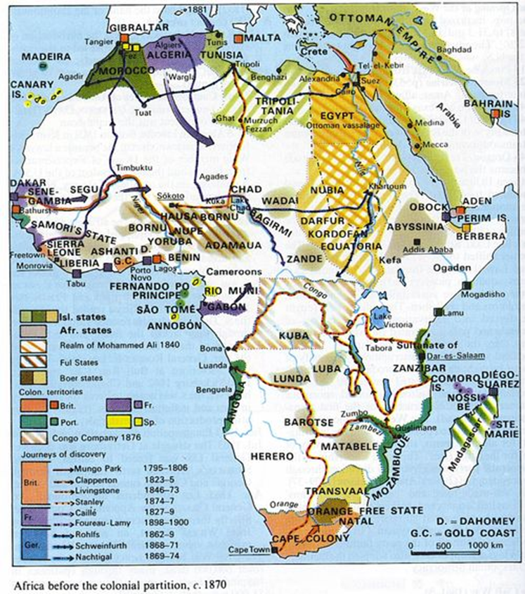

Slide 5
Congo Sparks Interest
Henry Stanley commissioned by King Leopold II of Belgium
Took control of Congo
Forced Africans to collect sap from rubber plants
10 million died
1908 Belgium took control of colony

Slide 6
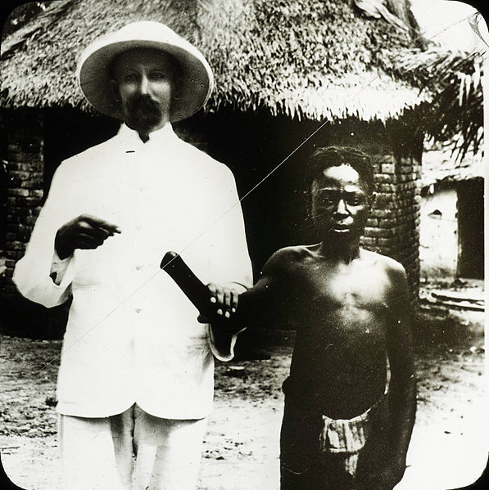

Slide 7
Forces Driving Imperialism
Spread of industrialization resulted in need for new markets and raw materials
Europeans wanted to take over foreign lands
Belief in European superiority
National pride
Racism
Social Darwinism
Fittest for survival enjoyed wealth and considered superior

Slide 8
Factors Promoting Imperialism
Europeans’ technological superiority
Maxim gun (1884)
Steam engine for navigation
Drug quinine (1829)
Played rival groups against each other

Slide 9
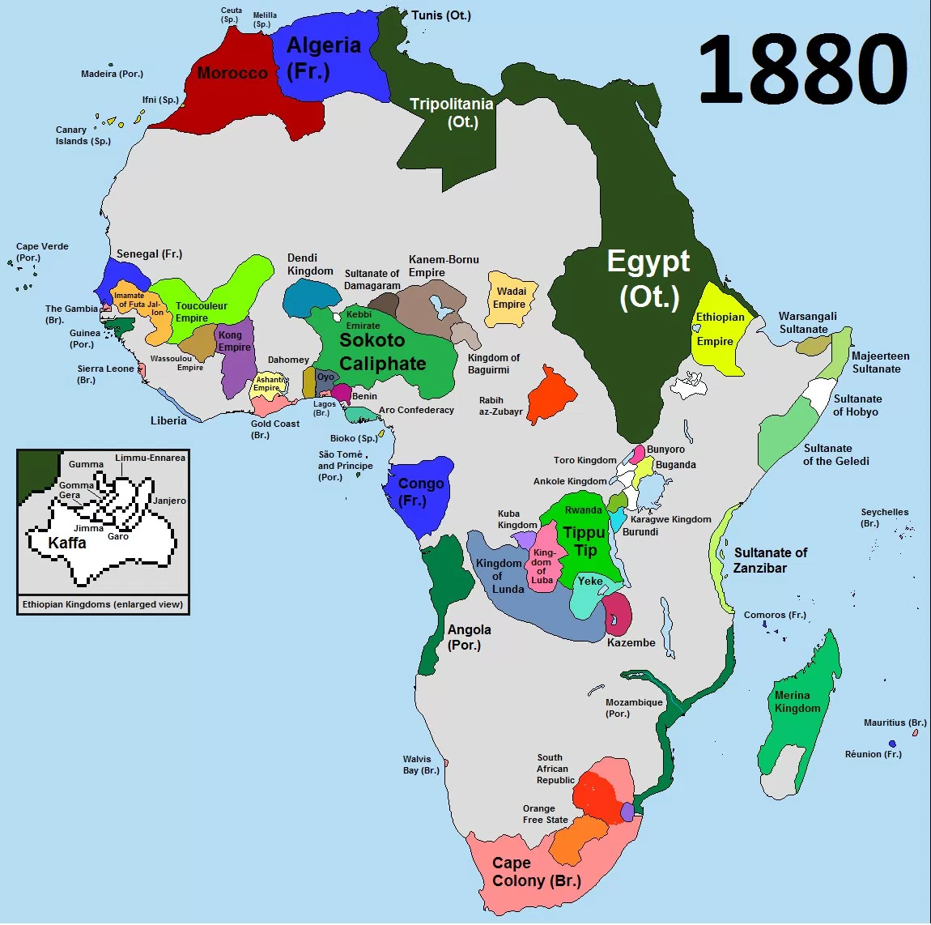

Slide 10
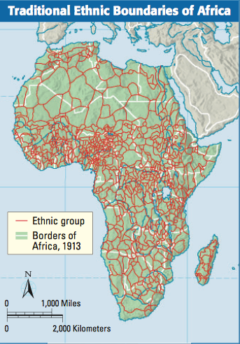

Slide 11
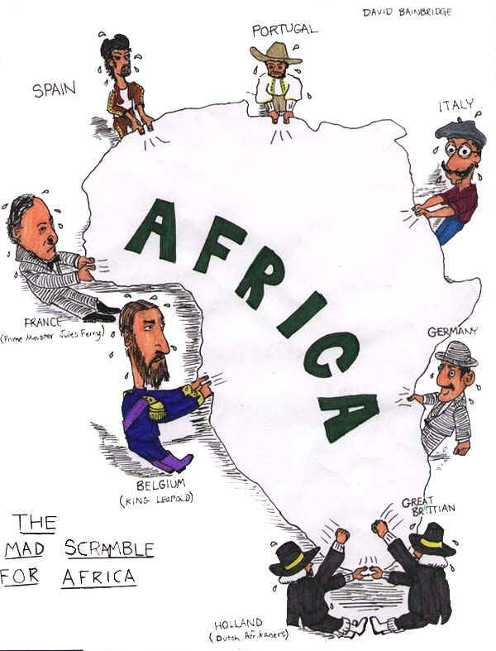

Slide 12
Berlin Conference
Discovery of diamonds/gold sped up competition for Africa resulted in fear of war
14 European nations met in Berlin (1884-85)
Agreed that they could claim lands if they could control them
By 1914 only Liberia and Ethiopia remained free

Slide 13
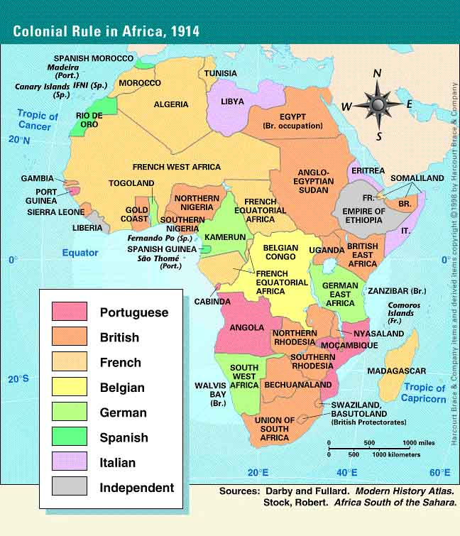

Slide 14
Clashing over Africa
1879: Zulus and British battled and lost in 1887
1889: Boer War
British vs. Boers (Dutch farmers)
Fought over S. Africa
First modern “total war”
British won – formed Union of South Africa

Slide 15
Methods of Control
Direct control
Paternalism
Governing by providing for needs but not giving rights
Assimilation
Supported by French
Immerse population in French culture and they would become more French
Indirect control
Asked a local ruler to rule under British authority
Legislative council including officials/locals

